Slide 1
JAVA

Slide 2
Enterprise Application
In today's world, social media websites have become an integral part of one's daily life. Sharing details of every moment of one's day, appreciating other's viewpoints or posts, sharing one's opinions, etc are some of the activities that we perform on a daily basis. And to be a part of this, one has to first log in to the particular website. Any leading social website has more than a billion users operating on it every day. The data shown to one user will be exclusive to that user and may not be shown to any other. Due to this, the amount of data that would have to be stored for this purpose would be huge.
Due to the huge amount of data involved, developing an application similar to a social media website would have to follow a few checkpoints,
It should be large-scale
It should have the potential to accept new functionalities after development
It should be secure
It should also be split into multiple isolated layers.
All these can be achieved by developing an Enterprise application.

Slide 3
An Enterprise Application is a software application that helps enterprises in managing their business-related activities. They are large and complex and solve business-related problems to fulfill the needs of the enterprises.
Few of the enterprise application you would have encountered till now are,
Sparsh
Yammer
Microsoft Outlook
Microsoft Skype
Yours truly (Lex)
Let us see the different layers in an enterprise application.
Since the enterprise application has been used for data manipulation of a large amount of data, it has become huge and complex. Maintaining such a complex application is challenging. And to resolve this, the enterprise application will be divided into different tiers.

Slide 4
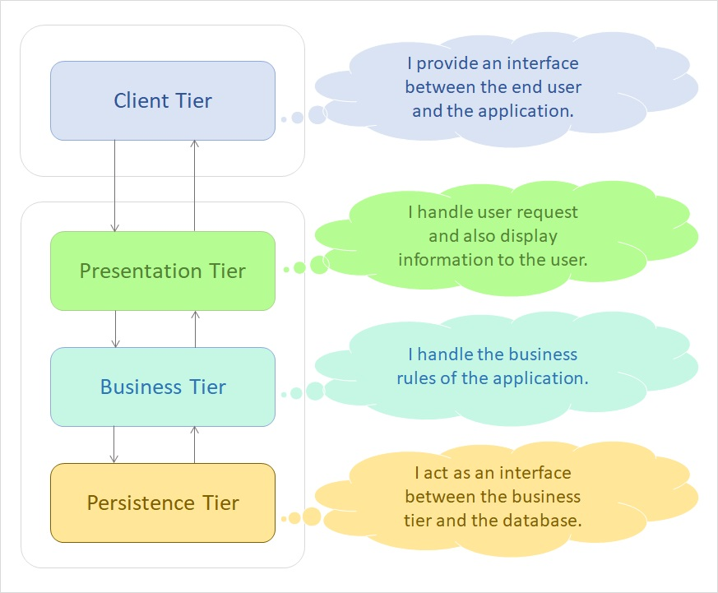

Slide 5
There are 4 tiers that the application is split into,
Client Tier: Acts as an interface to the end-user. Clients can be a web browser or standalone applications which is present in Computer, Mobile etc.
Presentation Tier: This tier links the business logic of the application and the end user. It also takes care of displaying dynamic content to the end-user and accepting various inputs from the user.
Business Tier: This is the most vital part of the application. This tier represents the complete business logic and requirements of the application. All the main functionalities, like data validations and data manipulations lie in this tier of the application.
Persistence Tier: This acts as a go-between for the business tier and the database. It gets the requirements from the business tier, and based on it accesses data from the database.
Let us see which technology we can use to set up an enterprise application.

Slide 6
What is an Enterprise Application?
You have seen the different tiers that an enterprise application is split into. Will Java be used in all the tiers? Or are there any other technologies used? Which technologies can one use in the multiple tiers created?
There are many technologies that can be used in different tiers, but we will be working with a specific set in this training.

Slide 7
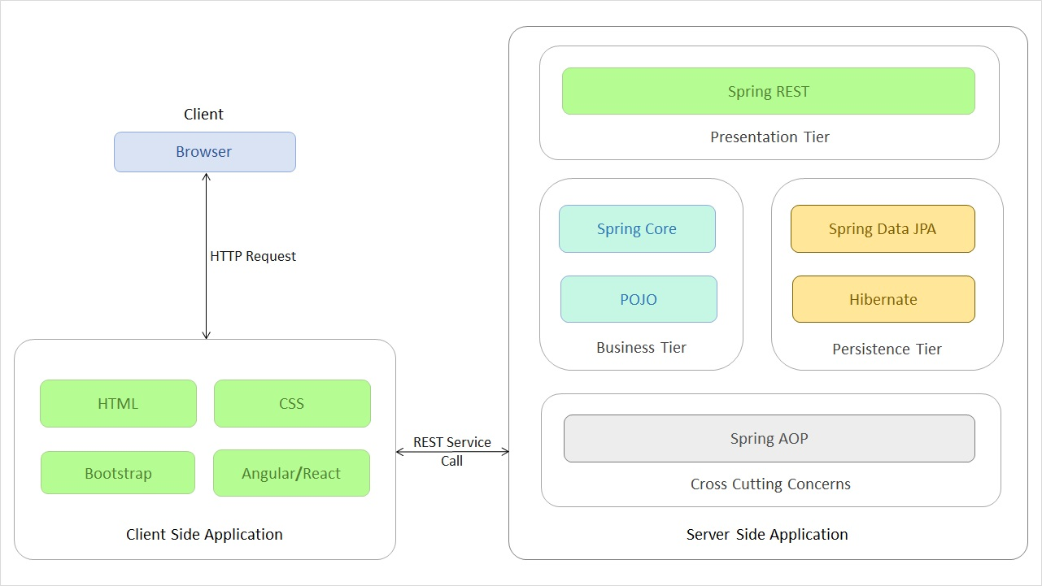
As you can see above, for different tiers, we are using different technologies. In this course, we will focus on the POJO(Plain Old Java Object) part of the Business Tier. POJO is a Java object which has not been bounded to any framework.
The other technologies and tiers will also be discussed in this training.
This course talks about how to create a Java application. Let us see how we split the Java application into the four tiers and how the data flows in the project.

Slide 8
As you saw in the previous page, an enterprise application is divided in four tiers (Client, Presentation, Business
and Persistence) with each having a specific functionality. But how do we split up our project to represent these tiers? Which aspect of our project goes to which tier?
For depicting this distinction, we have four different groups,
User Interface – This is the group that belongs to the Presentation Tier. This group contains the user interface package with a class called Tester. It takes care of processing the inputs from the user and relaying them to the concerned functionalities. For now, we are using a normal Java class. But in future we will use an HTML file to do so.
Service – This is the group that belongs to the Business Tier. This group contains the service package with many Service interfaces and classes. It takes care of authenticating the user inputs, as well as performing all the business logics needed for the application.
Validator – This along with the Service group belongs to the Business Tier. This group contains the validator package with different Validator classes. This class receives user input to be validated for proper format and data.
Data Access Object(DAO) – This is the group that belongs to the Persistence Tier. This group contains the Dao package with many DAO interfaces and classes. It helps the application in interacting with the Database. In this course, we will be mocking the database. In the future courses, we will use the actual database.
Model – This group contains classes which are used to transfer data from one class to the other.

Slide 9
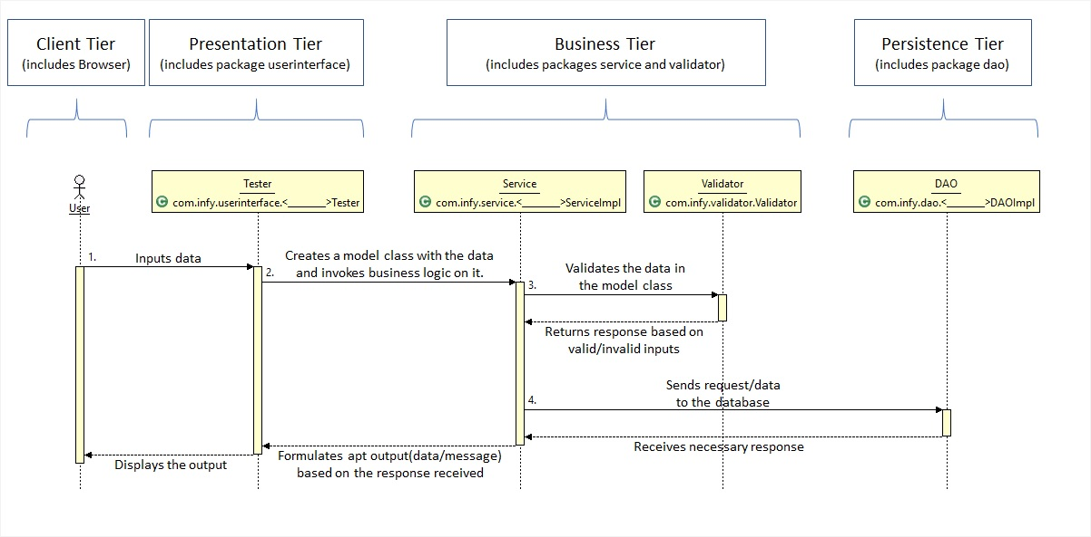

That being said, how does the control flow through each of these tiers? To demonstrate that, please have a look at the below image.

Slide 10
The different steps taking place in the image shown are,
User inputs the data. This data is sent to the Tester class (or the Presentation Tier).
The Tester class converts the raw data to a proper Model class object (Objects used to transfer data from one class to another) and send the object to the Service Class (Business Tier).
The Service class sends the object to the Validator class to get the inputs validated. If the inputs are in valid format, the Validator returns a successful response, else a failure response.
The Service class performs any business operation to be performed on the data before sending it to the DAO class (Persistence Tier).
The Persistence Tier interacts with the database and returns the response of the database.
Based on the responses from the Validator and the DAO classes, the Service class formulates either a successful output or a failure output and return the same to the Tester class.
The Tester class then displays this output to the User.
These steps are the fundamental procedures in any application. Different functionalities can have one or more of the above shown steps in a repeated pattern, but these steps will be there.

Slide 11
Java Architecture
In this course, we will be learning Java, one of the most popular programming language which is used to build an application.
Java has been evolving since 1991 with different editions. In this course, the features of Java till Java 11 has been discussed.
According to the TIOBE Programming Community Index, Java has been one of the top 5 programming languages for several years.
Billions of devices and enterprise desktops are powered by Java technology.
Let us look into the Java Architecture and Features next.

Slide 12
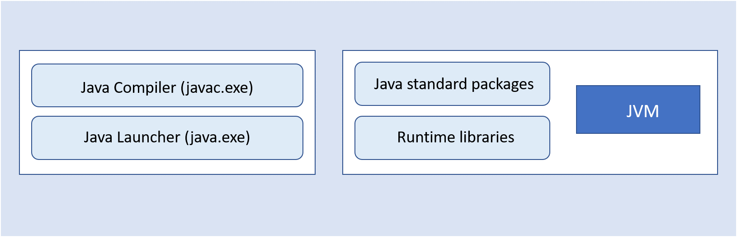
A Java program requires a Java development kit (JDK) for library support and development tools.
Java compiler (javac.exe): A Java compiler is a program that converts source files into the respective byte code. The byte code is platform-independent.
Java launcher (java.exe): Java launcher launches the Java application.
Java standard packages and runtime libraries contain the necessary code for executing Java applications.
Note: Previously, JDK came with a separate implementation for JRE (Java Runtime Environment). Now, starting from Java 11, Adopt OpenJDK does not come with separate JRE implementation; JDK will include JRE implementation. We will be using Adopt OpenJDK in this course.

Slide 13
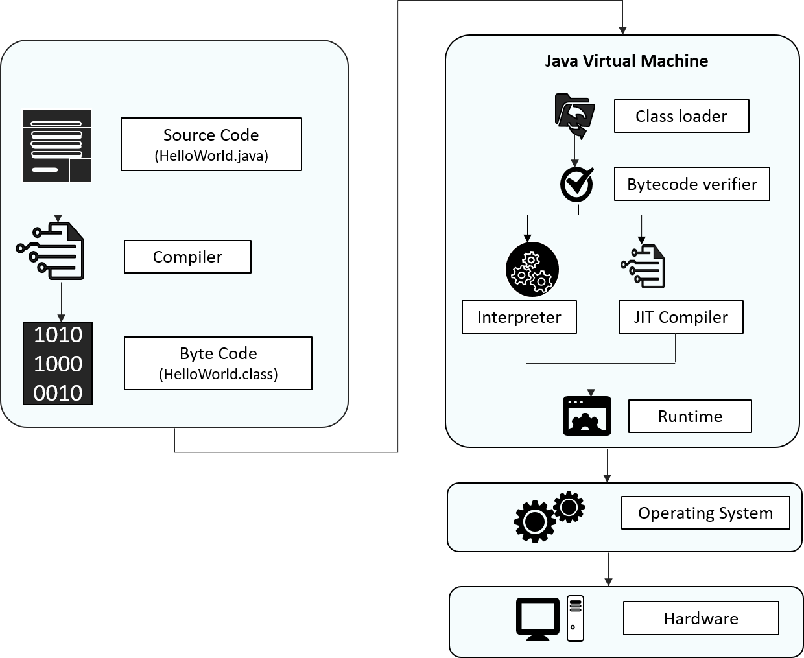
Let us look into the internal work of the Java program, how it is compiled and executed as shown below:

Slide 14
Source code: Program written in Java language
Byte code: A .class file is generated after the Java code is compiled
Class Loader: Loads all the class files needed for execution
Byte code verifier: Checks code for fragments for illegal code
Interpreter: Converts byte code instruction to machine code
Compiler: Compiles reusable byte code instructions to machine code
Runtime: The overall execution of the program is assisted by Runtime.
Note: Graal is a new JIT compiler written entirely in Java. Graal is a high-performance JIT compiler. Graal is independent of Hotspot VM and produces faster native code, which is used to get optimized performance. To know more refer Appendix
Next, let us discuss the different features of Java.

Slide 15
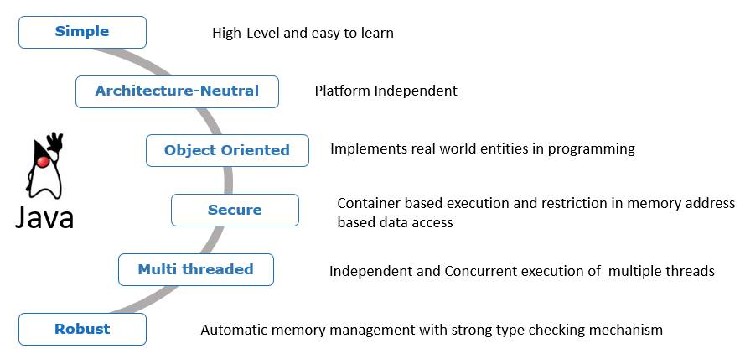
Features of Java
There are many features of java which contribute to its unique, distinguished and super exciting nature:

Slide 16
Simple:
Previously there were many complicated and rarely used features, which have been now removed, thus making Java easy to learn and understand. Apart from that, because of automatic garbage collection in Java, we don't have to deallocate unreferenced objects.
Architecture Neutral:
The compiler first compiles the code written in java and then converts into a "bytecode" (machine-understandable language) file. This feature makes Java platform-independent, as the bytecode file can be run on any platform (Windows, Linux, Mac/OS, Sun Solaris etc.)
Object-Oriented:
Object-Oriented concepts like Object, Class, Inheritance, Polymorphism, Abstraction, and Encapsulation is supported by Java.
Secure:
Java programs run inside a virtual machine sandbox. This enables us to develop more secure systems using Java.

Slide 17
Multi-threaded:
A thread is a separate program that executes concurrently. We can break down a monolithic program handling multiple tasks, into smaller multiple thread-like Java sub-programs that can deal with all the tasks at a given point in time. The main advantage of multi-threading is that threads share a common memory area. Threads are most importantly used for multi-media, web applications, etc.
Robust:
Java is considered robust because
there is strong memory management in Java
Java doesn't use pointers which thus avoid security problems
Java automatically garbage collects unused objects
it supports exception handling and type checking mechanism
Let us understand the concept of platform independence next.

Slide 18
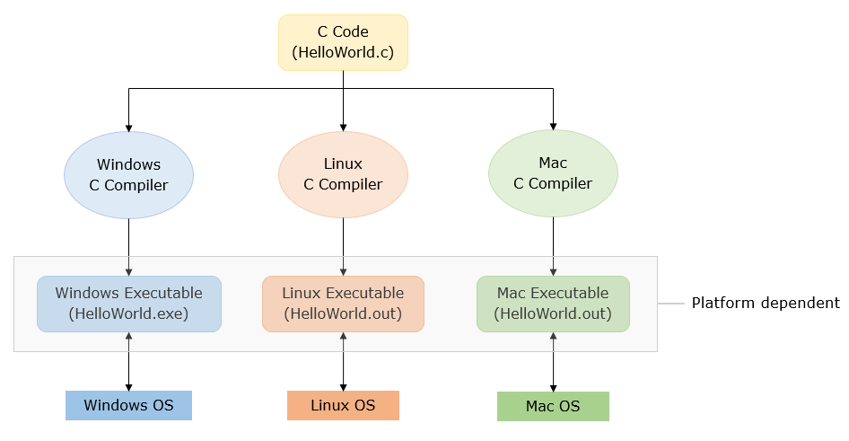
If a program written on a particular platform can run on other platforms without any recompilation, it is known as platform independence.
Since Java is platform-independent, any program written using Java on Windows will execute without any recompilation on any other platform.
To see what platform independence actually is and how it matters, let us compare Java to a platform-dependent language like C.

Slide 19
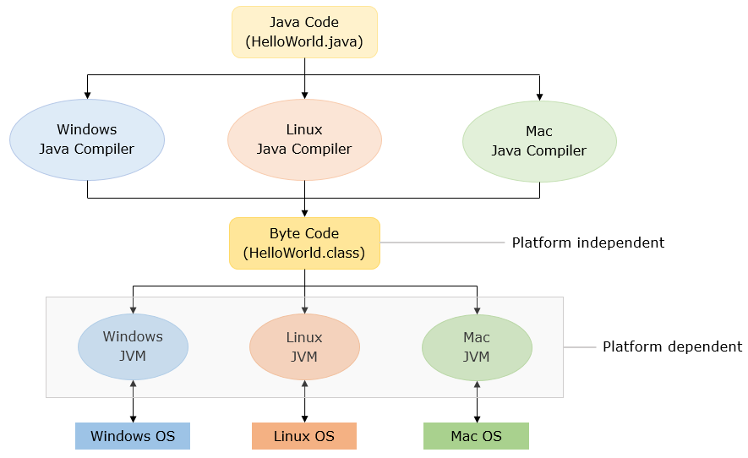
Java is platform-independent whereas JVM is platform dependent. Let us see how Java code executes in different platforms.
Now that we have discussed the features of Java, let us start coding in Java!

Slide 20
Introduction to JShell
Now that we have discussed a few features of Java, let us begin by coding a Java program that prints "Hello World!".
The Java code for printing "Hello World!" is,
public class DemoClass {
public static void main(String[] args) {
System.out.println("Hello World!");
}
}

Slide 21
Note: "main()" is the starting point of execution of all the programs.
The first thing that might come to your mind seeing this code might be, what are all those terms? I just started Java, and have no idea about class, static, public, etc. Those terms that you saw are the basic constructs in the Java language. Without them, Java does not work.
But you wanted to just print a normal "Hello World" and you just started learning Java. Would you have to learn all that to just print "Hello World"? Yes, you have to. To print a normal "Hello World", you do have to write a huge code as shown. But is that the only way to learn Java programming?
No, it isn’t. Due to a new addition in the Java language (from Java 9), learning of basics is simplified. That addition is the JShell.
Let us now see what's JShell.

Slide 22
What is JShell?
JShell is a command-line tool which can execute Java code snippets, and it does not require to write a complete Java program. It is Java REPL (Read-Evaluate-Print-Loop) like other languages such as Scala, Groovy, etc. With JShell, not only will the beginners find it easy to start learning the Java programming language, but the developers will also find it easy to test code snippets and incrementally build prototypes. JShell helps us try out code on different options, to test individual statements, and to explore different APIs. You can write the program elements one by one and see the results immediately.
How JShell works?
If you are wondering how snippets in JShell can be executed without having a class or a method, JShell uses the following steps to execute the code:
Code is parsed and its type is determined (variable declaration, expressions, method, class, etc.) 2. The code is wrapped inside synthetic methods and classes. Import statements are used as is 3. The wrapped source code is analyzed and compiled by the regular Java compiler 4. The generated bytecode is executed in a JVM, and the result is displayed by the JShell tool
Next, we will be using JShell to learn the fundamentals of Java.

Slide 23
How to work in JShell?
Now let us code the Hello World program using JShell. To execute the code in JShell, JShell tool needs to be launched in command prompt as shown below in steps
Step 1: Starting JShell To start JShell, enter the JShell command, JShell, in the terminal of IDE or command prompt. The following example shows the command and the response from JShell:
D:\Java11>jshell
| Welcome to JShell -- Version 11.0.1
| For an introduction type: /help intro
jshell>
JShell can also be launched with --start DEFAULT and --start PRINTING options which provide several library files made available by default.
PRINTING option to make the print methods available as top-level methods, allowing us to use methods like print(), println(), printf() directly on JShell. But unlike DEFAULT this will not add any frequently used libraries (for example Data Structure Libraries like List).

Slide 24
Using --start DEFAULT option
D:\Java11>jshell --start DEFAULT
| Welcome to JShell -- Version 11.0.1
| For an introduction type: /help intro
jshell>
Using --start PRINTING option
D:\Java11>jshell --start PRINTING
| Welcome to JShell -- Version 11.0.1
| For an introduction type: /help intro
jshell> println("Hello World!");
Hello World!
Step 2: After launching JShell write the following code on JShell command prompt and press enter to get the output:

Slide 25
jshell> System.out.println("Hello World!");
Hello World!
jshell>
Congratulations! Your first Java Program is executed using JShell.
Note: Every code written in JShell will have a specific id allotted to it. Using /list command, you can get a list of code snippets executed in JShell. As you can see below, we have executed only the print statement, and it has its id.
jshell> /list
1 : System.out.println("Hello World!");
jshell>
Step 3: Closing Jshell
We can exit from the JShell tool using the /exit command which will return you to the command prompt.

Slide 26
jshell> /exit
| Goodbye
D:\Java11>
Exceptions in JShell
In JShell, there is no need to handle checked exceptions. If a snippet throws a checked exception, the stack trace will be shown and JShell will continue. Though if a snippet throwing a checked exception is used inside a method, it will have to be handled or declared to be thrown.
Note: Checked Exceptions are the exception encountered during compile-time. We will discuss them further in the course.
For further reading on JShell, you can refer to the Oracle Docs by clicking Java Shell User’s Guide.
Let us see the Java Installations next.

Slide 27
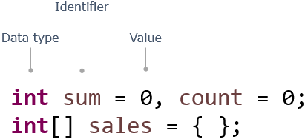
Keywords and Data Types
In programs, data values are stored in memory locations identified by names (identifiers). Such named memory locations are called variables.
Notice how variables are declared using types, identifiers, and assigned values:

Slide 28
As you have seen, a program is composed of several components, blocks, and words.
Some of these words are reserved and have a special meaning in Java, e.g. class, public, void, for, int, static. These words are called keywords. There are 50 keywords in Java 8.
Apart from keywords, there are other words that are used as names to identify components in a program, e.g. sum, index. These words are called Identifiers.
Identifiers are names used for identifying components of a program like classes, methods, interfaces, enums, and variables. Once declared, these names can be used to identify those components later in the program.
Now use JShell to execute the below code. Copy and paste the below code in JShell command prompt
int pizzaPrice = 250, totalCost = 0;
int quantity = 3;
System.out.println("TotalCost:" + pizzaPrice*quantity);

Slide 29
Rules for naming identifiers:
case sensitive
should not start with a number
should start with a letter, $ or _
should not have spaces
should not be a Java keyword or a literal
no restriction on the length
Note: The identifier should not have the only _ in its name.
Example :
Valid Identifiers: CustomerName, grade_in_first_attempt, marksScoredIn3rdAttempt
Invalid Identifiers: model number, 1ofAKind, double
Next, let us see how we can declare a variable.

Slide 30
Now let us see how to declare variables in Java. While declaring variables, we have to specify the kind of data they will hold.
A data type defines the type of data a variable can hold, its memory needs, and the operations that can be performed on it.
A variable can hold values only of the type specified at the time of its declaration.
Syntax: <data type> <identifier> = <value>;
For Example:
long totalCost = 0;
Data types are primarily of two kinds:
Primitive data types: Variables hold the value of data item. char in Java uses Unicode characters
Non-Primitive/Reference data types: Variables hold the reference of the memory location where the data item is stored. Note: Non-primitive types such as String, user-defined types, enum will be discussed later in the course.

Slide 31
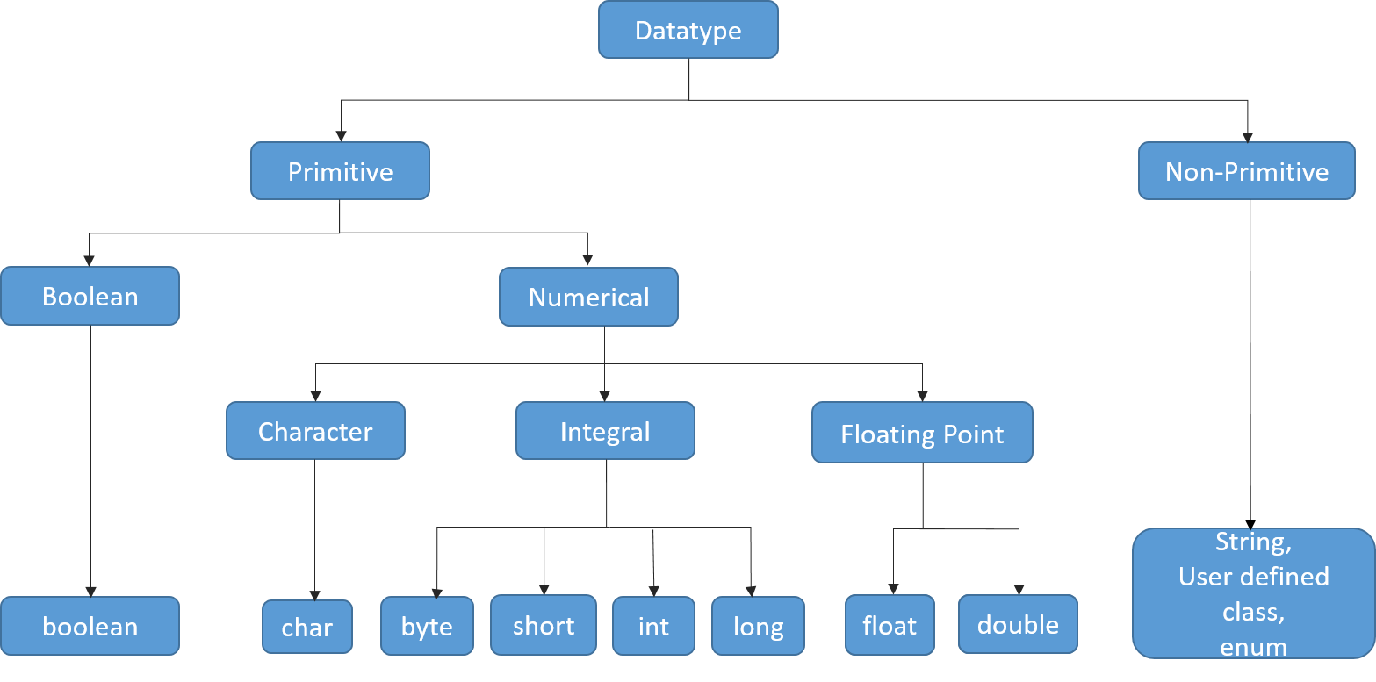
Let us have look at different data types in the below diagram in detail.

Slide 32
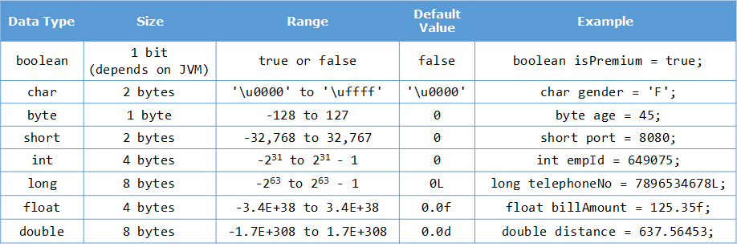
The default value and size occupied by each datatype with an example below.
Next, let us see how we can specify the datatype of a variable.

Slide 33
By now, you have seen that to declare a variable, you need to specify the data type of the variable but from Java 10 onwards, a new feature of local variable type inference has been introduced.
This feature allows you to specify var instead of the data type while declaring a variable as shown below.
var number=11;
In the above code snippet, you can notice that instead of a data type, var has been specified while declaring the variable.
In this case, the compiler infers the data type of the variable based on the value initialized to it.
Here, the compiler will infer the data type as int as an integer value has been initialized to the variable number.
Please note that var can only be used when a variable is initialized during declaration. var cannot be used when a variable is just declared without initialization.
The code snippet given below will result in a compilation error.
var number;

Slide 34
Once a variable declared with var has been initialized, you cannot even change the type of the value assigned
to the variable.
var number=11; //Line 1
number="Java"; //Line 2
The above code snippet will result in a compilation error as in Line 2, the value 'Java' of type String is assigned to the variable number but initially the type inferred for the variable number was int. This is not allowed.
Similarly a var variable cannot be initialized to null, which will result in compilation error if done. This is because it cannot determine the type of the variable from the value null.
var number=null;
You can now try these out in tryouts given later.
Let us discuss about operators next.
To manipulate variables and to do some operations on the data, we require operators.
Operators are symbols that perform specific operations on values and return a result. Java is loaded with a huge set of operators:

Slide 35
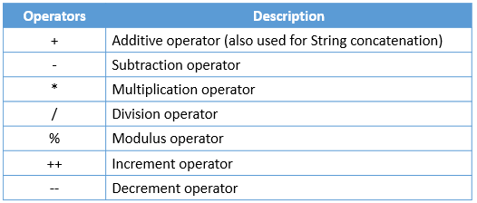
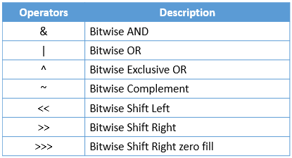
Arithmetic operators:
Bitwise operators:

Slide 36
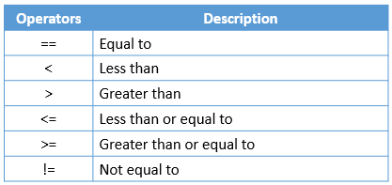
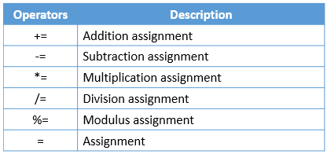
Relational operators:
Assignment operators:

Slide 37
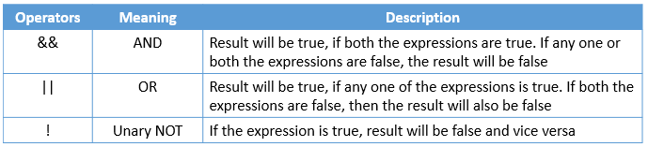
Logical operators:
Ternary Operator: It is a short form of if-then-else statement
Syntax: <condition> ? <statement if true> : <statement if false>;
For Example:
int a=30, b=50;
String result= a>b?"A is greeter is greater";

Slide 38
Use JShell to execute the below code
int pizzaPrice=280;
int quantity=2;
long totalCost = pizzaPrice * quantity;
if(totalCost>2000 && totalCost<=10000){
float totalCostWithDiscount = totalCost - (totalCost * (float)5/100);
}
else if(totalCost>10000){
float totalCostWithDiscount = totalCost - (totalCost * (float)10/100);
}
else{
System.out.println("No Discount");
}
Next, let us see how we can assign a value from one data type to another.

Slide 39
In Java, type conversion or type casting refers to the process of assigning a value from one data type to another. In most cases, to prevent the loss of information, any of the operand's value can be converted to a higher accommodating type.
Java supports two types of type conversion:
Explicit type casting
Explicit conversions are generally used to prevent data loss in mathematical operations. Also, when a value of larger data type needs to be stored as a value of smaller data type, despite the possibility of data loss, we should explicitly specify the conversion. In such a case, it is called narrowing conversion.
For Example:
float totalCostWithDiscount = totalCost - (totalCost * (float)5/100); // Explicit Type Casting
Implicit type casting
Implicit conversion happens when a value of smaller data type needs to be used as a value of larger compatible data type.
For Example:

Slide 40
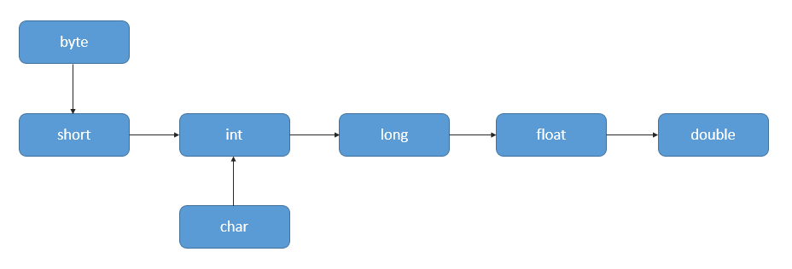
int intValue = 1002;
long longVariable = intValue;
//Here type casting is automatically done
Also called widening conversion, it is done automatically by Java. It follows the sequence below:
Next, let us see few tryouts on datatypes, var and operators.

Slide 41
Datatypes and var -Tryout
Problem Statement :
Play around with different data types and get familiar with declaring and initializing variables.
Data types are primarily of two kinds:
Primitive data types: Variables hold the value of data item. In Java char type uses Unicode characters
Non-Primitive/Reference data types: Variables hold the reference of the memory location where the data item is stored. Example: String
Java has var keyword to declare variables, which allows you to declare a variable without their type.
Below code is a simple Java program to demonstrates different ways of declaring and initializing a variable in Java

Slide 42
class DataTypesDemo{
public static void main(String[] args) {
int price = 100; //primitive data type
double discount = 25.5;
String size = "Medium"; //non-primitive data type
System.out.println("Prize after discount: "+price*(1-discount/100));
//Variable declared using var keyword
var customerName = "Rob Jones"; // infers String
System.out.println( customerName +" ordered a "+size+" pizza");
}
}

Slide 43
Local Variable Type Inference - Tryout
Problem Statement:
Try executing the code given below to understand local variable type inference. Uncomment the code and observe the result, to understand better.
class Tester{
public static void main(String[] args){
//Variable declared using var instead of data type
var numberOne=11; //The type of the variable is inferred by the compiler
System.out.println("The value of numberOne is "+numberOne);
//Uncomment the code given below and observe the output
//var numberTwo;
//Uncomment the code given below and observe the output
//numberOne="Java";
}
}

Slide 44
Operators tryout
Problem Statement :
The code given below demonstrates the use of operators
Let’s see code ..

Slide 45
class Tester {
public static void main(String[] args) {
int year = 1900;
boolean leap = false;
if(year % 4 == 0){
//since every 100th year is not a leap year, so
if(( year % 100 == 0) && (year%400==0))
//checking for century year is leap year or not
leap = true;
else if(year % 100 != 0)
leap = true;
else
leap = false;
}
else
leap = false;
if(leap)
System.out.println(year + " is a leap year.");
else
System.out.println(year + " is not a leap year.");
}
}

Slide 46
Keywords and DataTypes - Exercise
Problem Statement:
Here is a program to convert temperature from Fahrenheit to Celsius.
To do: Add code to convert the temperature to Kelvin.
class DataTypeDemo
{
//The method converts temperature from one unit to another
public static void main(String[] args) {
double fahrenheit = 212.0; // Input in Fahrenheit
double celsius =(( 5 *(fahrenheit - 32.0)) / 9.0); // conversion from fahrenheit to celsius
System.out.println(fahrenheit + " degree Fahrenheit is equal to " + celsius + " in Celsius");
//Write code here to convert temperature to Kelvin
}
}

Slide 47
Introduction to Class
As we have seen, Java follows Object Oriented Programming concepts and classes and objects are basic concepts of Object Oriented Programming which revolve around the real-life entities.
A class is a design or blueprint that describes the characteristics and behaviors of a real-time entity. In other words, the class is a user-defined data type in Java.
It starts with the keyword "class" followed by a name.
It specifies attributes (characteristics) and methods (behaviors).
Attributes are the elements (instance variables) which hold the values of a particular entity that define its characteristics.
Methods are the sets of instructions that define the behaviors of the entity.

Slide 48
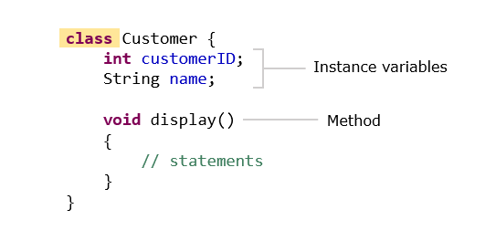
An example of creating a class can be seen below,
In the above class definition, we can see that the attributes are the variables of the class. But what is a method and what is its importance in a class?
So, let us discuss about methods next.

Slide 49
A method is a set of statements which depicts the behavior of a class. We have already encountered the
main method.
To execute any program, the compiler always needs an initial/entry point to start from. In case of Java programs, that initial/entry point is marked by the main()method present in the program. Without this method, the JVM cannot start executing the program. The syntax can be given as:
public static void main(String[] args){
//statements
}
public: This specifies the level of access of the method within and outside the program. And to make main() method visible to JVM, the level of access must be set to "public". If the same is anything except public (private, protected or default) the JVM will be unable to see the initial/entry point of the program. And hence the program will not run.
static: Generally, a Java program is in the form of a class. And whenever we create classes in Java, we need to create instances/objects to access the class methods and attributes. The same applies to main() method also. But by declaring a class method as "static", we can call the method without creating instances of the class. Hence we declare the main() method as static.

Slide 50
void: In Java, every method is expected to return a value of any type (integer, double, string etc.). And to make a method not return any value, it must be declared "void". Since the main() method is not expected to return any value, it must be declared as void.
main(): As discussed above, a Java program is basically a class. And the main() method is the default method of this class. This method marks the initial/entry point of the Java program.
String args[]: Now a program in general may take inputs from the users. In Java, they are usually in the form of multiple strings as "command line arguments" grouped as an array of string. This string array is taken as the argument in the main() method.
Now, let us define a method.

Slide 51
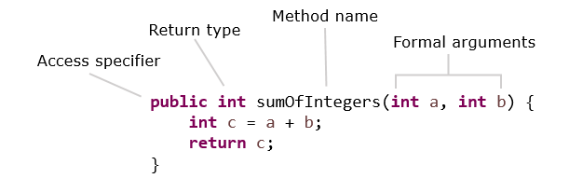
A method definition looks as shown below :
The first line of the method contains the method signature, which includes the name of the method and the arguments (parameters) it takes.
Methods need to be called or invoked to execute the statements present inside the method.

Slide 52
The code given below demonstrates a method and the way to call or invoke the method.
public class Calculator {
// Method definition - here, numberOne and numberTwo are formal parameters or arguments
int calculateSum(int numberOne, int numberTwo) {
return numberOne+numberTwo;
}
}
public class Tester {
public static void main(String[] args) {
Calculator calculator=new Calculator();
int numberOne=11;
int numberTwo=1;
//Method call - here, numberOne and numberTwo are actual parameters or arguments
int sum=calculator.calculateSum(numberOne, numberTwo);
System.out.println("The sum is "+sum);
}
}

Slide 53
Arguments of a method are optional. The arguments specified in the method definition are called formal arguments or parameters. The arguments or parameters that are used in the method call are known as actual arguments or parameters.
Methods may or may not return a value after execution.
The return keyword is used to return a value from the called method to the calling method.
The return type specifies the data type of the value to be returned.
If a method does not return anything, the return type should be specified as void.
In the code given above, the value returned by the method will be stored in the variable sum.
Next, let us see how to create objects.

Slide 54
Object Creation
Till now we have learnt to create a class. A Java class, is a blueprint so how do we use it? It can be done by providing some values to the attributes of the class. This is called the instantiation of a class and the entity we get after instantiation is called the object.
An object is an instance of a class.
It allows us to use the attributes and behaviors specified in the class.
A class can have any number of objects.
An object holds data related to one instance of a class.
In Java, an object is created by using the new keyword.

Slide 55
Let's create an object for the Customer class shown below:
class Customer {
String customerName;
// getter method - returns the customerName of the object
String getCustomerName() {
return customerName;
}
//setter method - sets the customerName of object to the specified value
void setCustomerName(String customerName) {
this.customerName = customerName;
}
}
An object for the class can be created as shown below:
Customer customerObject = new Customer();

Slide 56
Methods and attributes can be invoked by using the "." operator:
customerObject.customerName = "Ron";
System.out.println("Hello "+customerObject.getCustomerName()); //Output : Hello Ron
// To change the name we use setter method
customerObject.setCustomerName("Jack");
System.out.println("Hello "+customerObject.getCustomerName()); //Output : Hello Jack
Note :
During object creation, the instance variables are automatically assigned default values (for example: 0 for integer, 0.0 for double, null for String etc.) based on their respective datatypes.
Local variables declared inside methods have to be initialized with relevant values before they can be used.
Looking at the object creation, do you notice that we are calling a function having the same name as that of our class? We have created only one method in the Customer class, i.e., display(). There is no function with the name Customer(). So how are we calling it?
Let us see a tryout on objects next.

Slide 57
Constructor and this keyword
A constructor is a method which has the same name as the class. It is a special method as it does not return any value, and is used for creating objects and initializing their values.
Syntax:
<<classname>>(){ }
For Example:
//Constructor
Customer(){ }
//Constructor above is called while creating objects as shown below,
Customer custObj = new Customer();
Here, Customer() indicates constructor invocation during object creation

Slide 58
Types of constructors:
Non-Parameterised/Default constructor
A constructor which doesn't take any parameter
If the programmer doesn't provide any constructor, a non-parameterized/default constructor will be provided by the compiler.
Parameterised Constructor
A constructor which accepts parameters (arguments)
//Parameterised constructor
Customer(int customerId) {
System.out.println(customerId);
}
//Constructor above is called while creating objects as shown below,
Customer custObj = new Customer(1001);
Note: If the programmer provides a parameterized constructor then the default constructor is not provided by the compiler.
Next, let us learn about the 'this' keyword.

Slide 59
Now let us consider a situation where a method has an argument or a local variable which has its name similar to an instance variable. Who gets the higher preference, the local variable/argument or the instance variable?
Surprisingly, the local variable gets the higher preference than the instance variable inside the method. And this is known as shadowing of a field. So, how do we use both the instance variable and the local variable/argument together?
How do we call any constructors or methods of a class, from a method of the class?
class Customer{
String customerName;
public Customer(String customerName) {
customerName = customerName;
}
public void display () {
System.out.println("Customer Name : "+customerName); // Output :- Customer Name : null
}
}
public class Tester {
public static void main(String[] args) {
Customer customer1 = new Customer("Jack");
customer1.display();
}
}

Slide 60
Here, the variable 'customerName' used in the constructor is local to that constructor. The instance variable (customerName) name will remain null. To assign the value passed into the constructor to the instance variable 'customerName' and to call the display() method, this keyword can be used as shown below:
class Customer{
String customerName;
public Customer(String customerName) {
this.customerName = customerName;
}
public void display () {
System.out.println("Customer Name : "+customerName); // Output :- Customer Name : Jack
}
}
As we have learnt to invoke attributes using this, can we invoke methods using this? Let us see how to do that next.

Slide 61
this keyword is also used to invoke the constructor or any method of the current object.
Observe the code given below:
public class Customer {
public String customerId;
public String customerName;
public long contactNumber;
public String address;
public Customer() {
System.out.println("Parameterless constructor called");
}
public Customer(String customerId, String customerName, long contactNumber,
String address) {
// this() is used to invoke the constructor of the current class
// Since no parameters are specified, parameterless constructor will be invoked
this();
this.customerId = customerId;
this.customerName = customerName;
this.contactNumber = contactNumber;
this.address = address;
}
See the continuing code in next ..

Slide 62
public void displayCustomerName() {
System.out.println("Customer Name : " + customerName);
}
public void displayCustomerDetails() {
System.out.println("Displaying customer details \n***********");
System.out.println("Customer Id : " + customerId);
//this is used to invoke method
this.displayCustomerName();
System.out.println("Contact Number : " + contactNumber);
System.out.println("Address : " + address);
}
}

Slide 63
We will create a Tester class for the same, which will have input as follows:
public class Tester {
public static void main(String[] args) {
Customer customer = new Customer();
customer.displayCustomerName();
customer.displayCustomerDetails();
Customer customer1 = new Customer("K123","Katy",7865l,"21A, Downtown, LA");
customer1.displayCustomerName();
customer1.displayCustomerDetails();
}
}
For an object customer, we are calling parameterless constructor which is printing the statement "Parameterless constructor called" and is not setting any attributes, hence it will set them to null. And customer1 is calling the parameterized constructor which is calling parameterless constructor (using this() ) and setting the value of the attributes.

Slide 64
After executing the above code we will get the output as :
Parameterless constructor called
Customer Name : null
Displaying customer details
***********
Customer Id : null
Customer Name : null
Contact Number : 0
Address : null
Parameterless constructor called
Customer Name : Katy
Displaying customer details
***********
Customer Id : K123
Customer Name : Katy
Contact Number : 7865
Address : 21A, Downtown, LA
You can further explore this concept in the tryout.

Slide 65
Class Diagram
By now you learnt how to create a class, its attributes or instance variables, methods and constructors. It is also important to understand how to represent them so that anyone can understand about the class even without comprehensive knowledge in programming languages. Class diagrams helps in achieving this.
Class diagrams are used for diagrammatically representing the classes, its structure and relationship with other class.
Class diagram mainly describes the attributes and methods of a class. Relationships and the dependencies between Java classes, interfaces, enums, fields, methods, references etc. can also be modelled using a class diagram.
It also helps in constructing executable code of an enterprise application. Class diagram is the only UML (Unified Modeling Language) diagram which can be directly mapped to object-oriented languages and therefore, is one of the most widely used UML diagrams.
In UML class diagrams, a class is represented by a rectangular box with its class name on top and divided into different sections. The first section represents all the attributes of the class and the second represents methods.

Slide 66
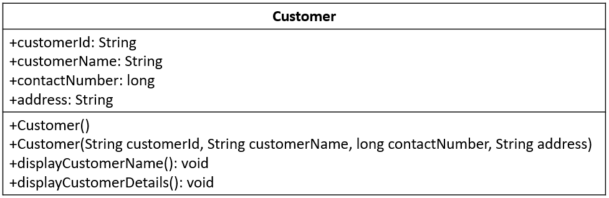
Below is the UML class diagram of a class Customer which we discussed in the previous tryout.
The symbol + denotes that the members of the class are publicly accessible. Similarly, there are other symbols representing accessibility of members.

Slide 67
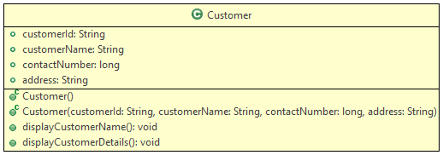
Class diagrams can also be generated using IDEs.
Below is the class diagram for the class Customer, generated using Eclipse IDE.
Each symbol has its own meaning as per the access modifier and the type of attributes and methods.
The green color represents the class or its variables are having public accessibility.

Slide 68
Coding Standards
Now that we have seen how we can work with classes and objects, let us discuss few coding standards that are followed in Java.
Java follows certain conventions when it comes to naming variables, packages, classes, methods, and interfaces i.e. identifiers. The programs are more understandable if meaningful names are provided for the identifiers. The following conventions are followed:
Identifiers can contain alphabets, numbers, underscore( _ ), and the dollar sign. ( $ ). There is no restriction in the length.
Reserved keywords should not be used for naming identifiers.
Class names should follow PascalCasing i.e the first letter and the first letter of each internal word should be capitalized. Example: StringBuffer, EmployeeDemo
Method names should follow camelCasing i.e the first letter should be in lowercase and the first letter of each internal word should be in uppercase. Example: display, getEmployeeName
Variable names should start with lowercase and the first letter of the subsequent words should be in uppercase. Example: total, averageCount
Constants should be in uppercase with each word separated by an underscore. Example: PI, MIN_LENGTH
Let us discuss few other concepts such as control structures next.

Slide 69
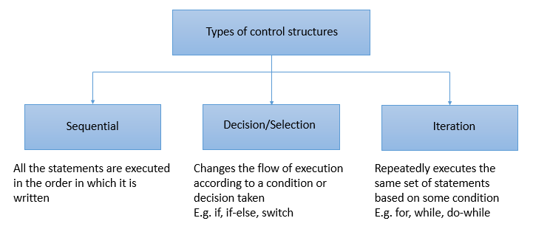
Control Structure
In a program, the instructions are usually executed line by line. Sometimes, all the statements in a program may not be executed. There can be a change in the flow of control and can be implemented using control structures.

Slide 70
The selection control structures available in Java are:
if-else
if-else if
Switch
The iteration control structures available in Java are:
while loop
do-while loop
for loop
for-each loop

Slide 71
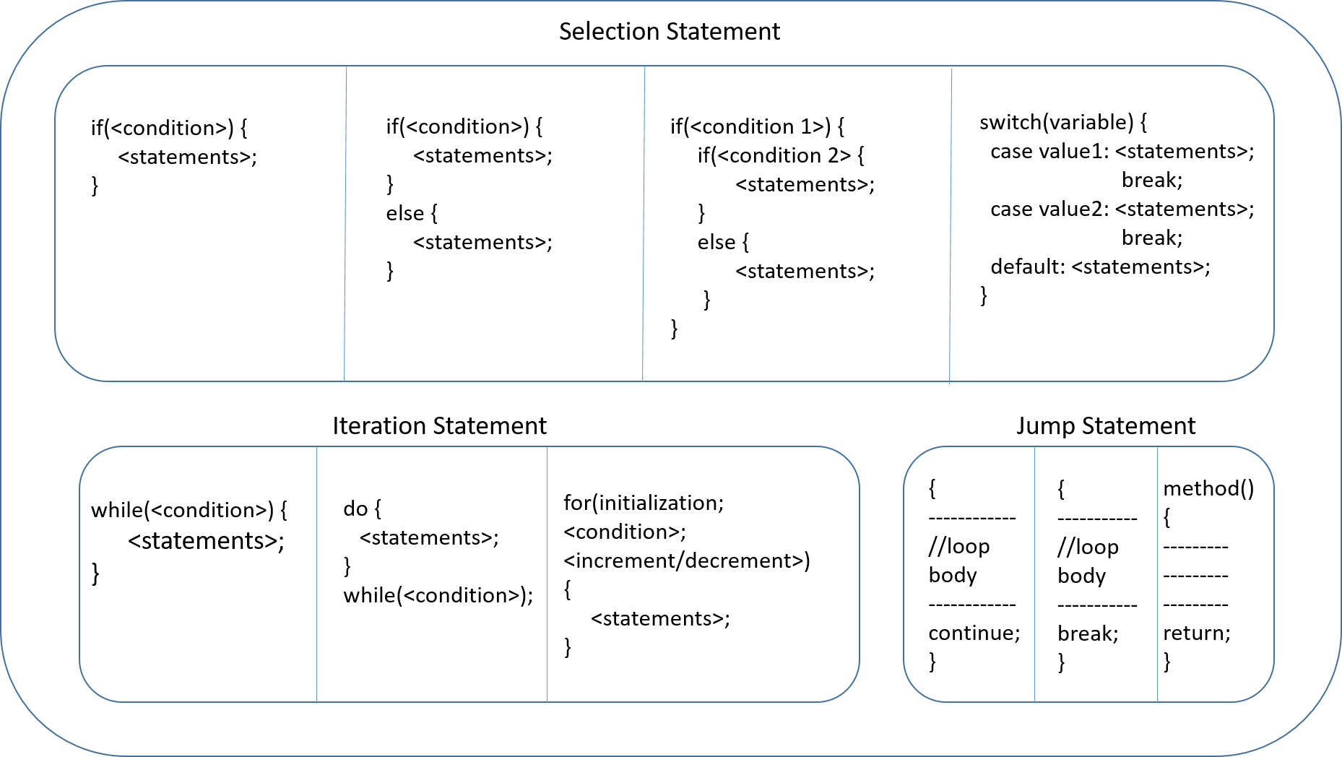
The syntax of the various control structures is given below.

Slide 72
If Else - Tryout
Problem Statement :
The code given below checks whether a given number is even or odd using if-else block. Execute the code by assigning different values to number variable.
//Java program to check whether the given number is even or odd
//Observe the output for different values of a number variable
class Tester {
public static void main(String[] args) {
int number = 5;
if (number % 2 == 0) {
// This block will get executed if the if-condition is true
System.out.println(number + " is an even number");
} else {
// This block will get executed if the if-condition is false
System.out.println(number + " is an odd number");
}
}
}

Slide 73
Problem Statement:
The code given below displays the grade of a student based on the marks using if-elseif blocks.
Execute the code with different values of marks and observe the output.
//Observe the output for different values of marks
class Tester {
public static void main(String[] args) {
int marks = 90;
if (marks < 50) {
System.out.println("Fail");
} else if (marks >= 50 && marks < 60) {
System.out.println("D grade");
} else if (marks >= 60 && marks < 70) {
System.out.println("C grade");
} else if (marks >= 70 && marks < 80) {
System.out.println("B grade");
} else if (marks >= 80 && marks < 90) {
System.out.println("A grade");
} else if (marks >= 90 && marks <= 100) {
System.out.println("A+ grade");
} else {
System.out.println("Invalid!");
}
}
}

Slide 74
Switch - Tryout
Problem Statement:
Execute the code given below and observe the output. Modify the code to get 5% discount for Regular customer and 10% for Premium customer. Also, try changing sequence of the cases, observe how it works if default is written before other cases.
//Observe the output for different values of customerType
class Tester {
public static void main(String[] args) {
double discount;
String customerType = "Premium";
switch (customerType) {
case "Regular":
discount = 5;
case "Premium":
discount = 10;
default:
discount = 0;
}
System.out.println("Customer has got discount of " + discount + "%");
}
}

Slide 75
While - Tryout
Problem Statement
Below try out to calculate the sum of all digits in a given number using while loop.
//Observe how to obtain sum of all digits in a Number
class Tester {
public static void main(String[] args) {
int inputNumber = 7865; //Supply different inputs here
int sumOfDigits = 0;
int temp = 0;
while (inputNumber > 0) {
temp = inputNumber % 10;
sumOfDigits += temp;
inputNumber = inputNumber / 10;
}
System.out.println("Sum of digits are : " + sumOfDigits);
}
}

Slide 76
Do While - Tryout
Problem Statement
Try the below code to calculate the sum of all digits in a given number using do-while loop.
//Observe how to obtain sum of all digits in a Number
class Tester {
public static void main(String[] args) {
int inputNumber = 9654; //Supply different inputs here
int sumOfDigits = 0;
int temp = 0;
do {
temp = inputNumber % 10;
sumOfDigits += temp;
inputNumber = inputNumber / 10;
} while (inputNumber > 0);
System.out.println("Sum of digits : " + sumOfDigits);
}
}

Slide 77
For loop- Tryout
Problem Statement
Below code is used to generate the customerId using for loop. Observe the output.
The usage of var in declaring the variable to be initialized inside a for loop is also demonstrated.
class Customer {
public static void main(String[] args) {
// The below code generates customerId
int totalNoOfCustomers = 12;
String customerId = "";
for (int counter = 1; counter <= totalNoOfCustomers; counter++) {
if (counter <= 9)
customerId = "C0" + counter;
else
customerId = "C" + counter;
System.out.println("Customer Id for customer " + counter + " is "
+ customerId);
}
// Uncomment the below given code and execute it instead of above for loop
// for understanding the usage of var in a for loop
/*
for (var counter = 1; counter <= totalNoOfCustomers; counter++) {
if (counter <= 9)
customerId = "C0" + counter;
else
customerId = "C" + counter;
System.out.println("Customer Id for customer " + counter + " is "
+ customerId);
}*/
// The local variable used in the for loop is declared using var
// type of that variable will be inferred based on the value initialized
}
}

Slide 78
For Each loop - Tryout
Problem Statement:
Below code to is used to calculate the sum of even numbers in an array. Execute the code and observe the output.
The usage of var in declaring the local variable inside a for-each loop is also demonstrated.
//Observe how to obtain sum of even numbers in an array
class Tester {
public static void main(String[] args) {
int[] numbers = {68,79,86,99,23,2,41,100};
int sum=0;
//for-each loop (Enhanced for Loop)
for(int number:numbers) {
if(number%2==0)
sum+=number;
}
// Uncomment the below given code and execute it instead of above loop
// for understanding the usage of var in a for-each loop
/*
for(var number:numbers) {
if(number%2==0)
sum+=number;
}*/
// The local variable used in the for-each loop is declared using var
// type of that variable will be inferred based on the values inside the array
System.out.println("Sum of even numbers: "+sum);
}
}

Slide 79
Package
Imagine walking into a library to get your favorite novel, but welcomed by a room full of an unorganized stack of books. Would you still go ahead and search for the novel?
Of course not!
Just as books are cataloged and arranged in a library, it is important for us to organize our Java files. This can be done with the help of packages.
A package is a set of logically related classes.
A package helps in controlling access and avoiding name conflicts among them.
You need to provide unique names to packages inside a project.

Slide 80
How would you name a package?
The convention for naming packages is to use all lower case alphabets. This is done to avoid conflicts with names of classes.
Also, organizations use reverse internet domains for naming packages.
E.g. - A package created for an internal application of Infosys can be named as com.infy.
Now that you know about the package and its naming convention, you will now see how to create a package.

Slide 81
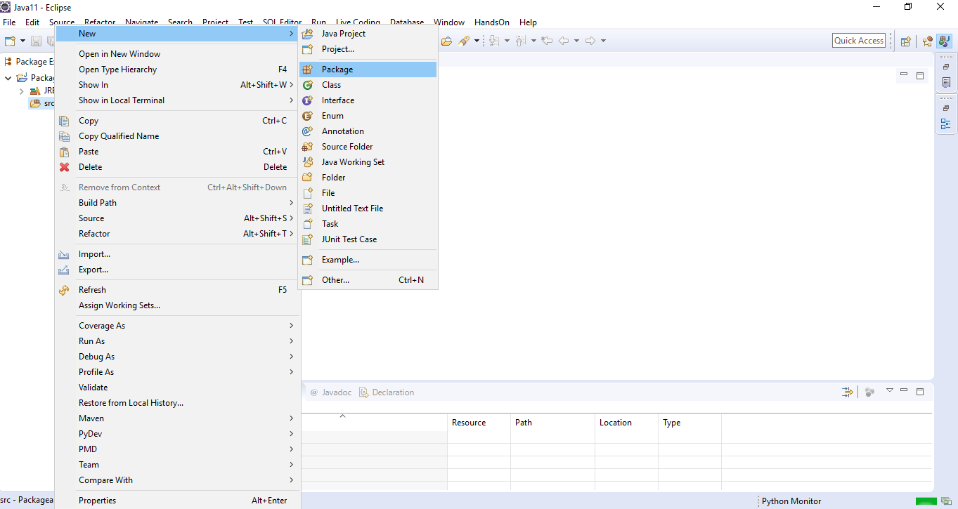
To create a package, right-click on src and select New>Package to create a new package as shown below.

Slide 82
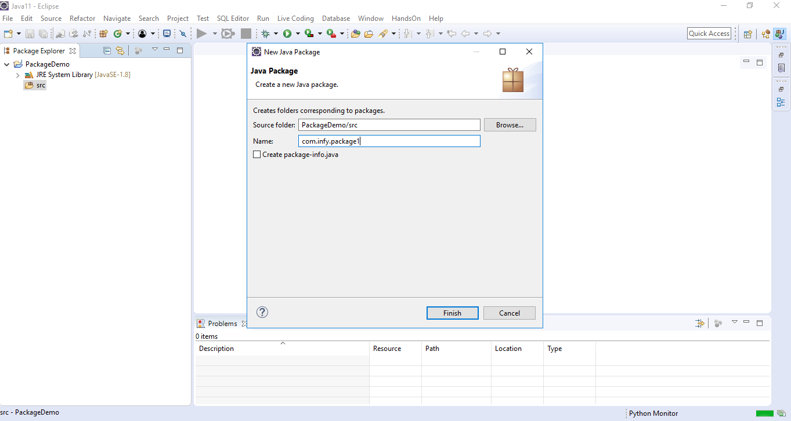
Next, you need to provide a name to the package as shown below

Slide 83
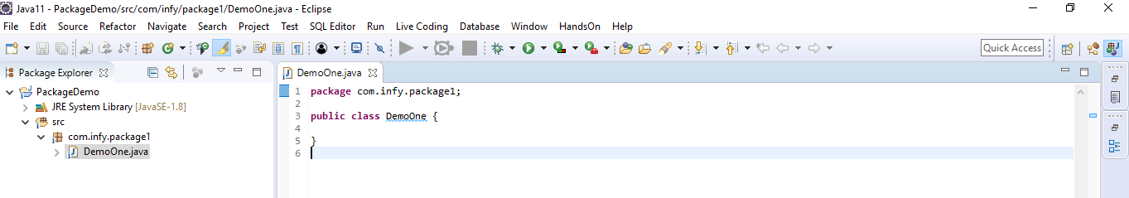
The package is named as 'com.infy.package1' in the screenshot given above. Please observe that each alphabet is in lower case and also reverse internet domain has been used while naming the package.
Once a class is created inside a package, the package keyword specifies the name of the package as shown below. This should be the first line of a .java file.
Classes of one package can also be used in other packages.
How do you use classes of one package in another package?
To use a class of one package in another package, an import statement needs to be used which will be demonstrated to you through a demonstration shown later.
Let us discuss access modifiers next.

Slide 84
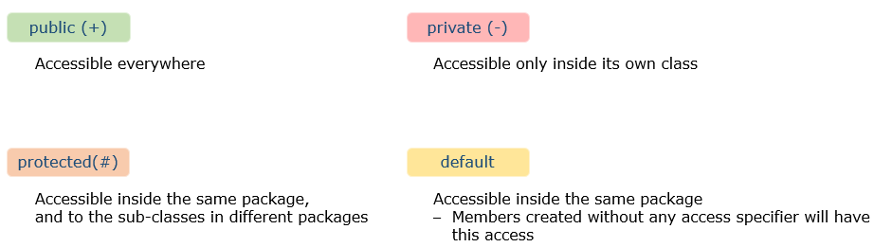
Access Modifiers
Now that you have understood packages, let us also discuss access modifiers.
You would have seen the keyword 'public' in multiple places. The keyword public is an access modifier.
Access modifiers are used to control the visibility of a class and its members. This facilitates encapsulation.
There are 4 access modifiers in Java - public, private, default and protected.
Out of these 4, you will learn more about protected later in the course.
Note: A class can have only public or default access.

Slide 85
Since you have now learnt about the different access modifiers, we will see how they are represented in class diagrams.
Consider the below code snippet for the class Customer.
Let’s see in next slide..

Slide 86
public abstract class Customer {
public String customerId;
protected String customerName;
long contactNumber;
private String address;
private static int idCounter;
public Customer() {
System.out.println("Parameterless constructor called");
}
public Customer(String customerId, String customerName, long contactNumber, String address) {
this.customerId = customerId;
this.customerName = customerName;
this.contactNumber = contactNumber;
this.address = address;
}
public void displayCustomerDetails() {
System.out.println("Displaying customer details \n***********");
System.out.println("Customer Id : " + this.customerId);
System.out.println("Customer Name : " + this.customerName);
System.out.println("Contact Number : " + this.contactNumber);
System.out.println("Address : " + this.address);
}
public String updateCustomerContact(long newContact) {
String message = null;
if (this.contactNumber != newContact) {
this.contactNumber = newContact;
message= "Contact updated";
}
else
message = "Provide a new contact";
return message;
}
public abstract void calculateFinalPrice();
}

Slide 87
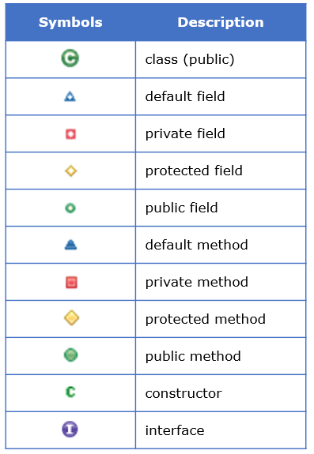
Below is the class diagram for the above given Customer class.
Different symbols used in the above class diagram is explained below:

Slide 88
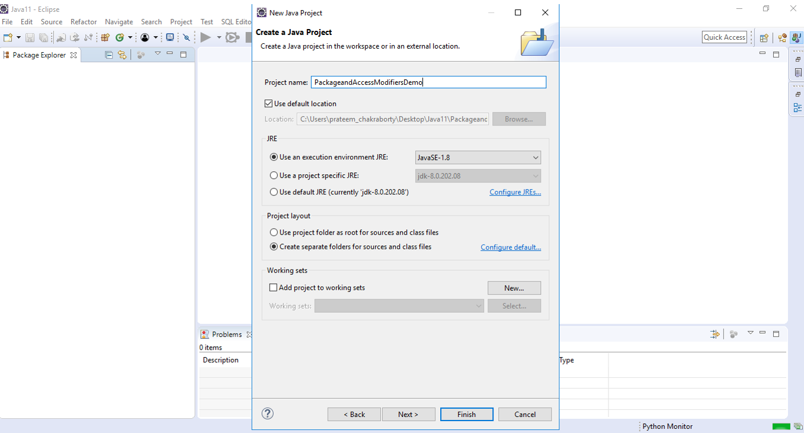
Package and Access Modifiers – Demo
Please follow the steps given below to understand packages and public, private and default access modifiers in Java.
Step 1: Create a project named PackageandAccessModifiersDemo as shown below.

Slide 89
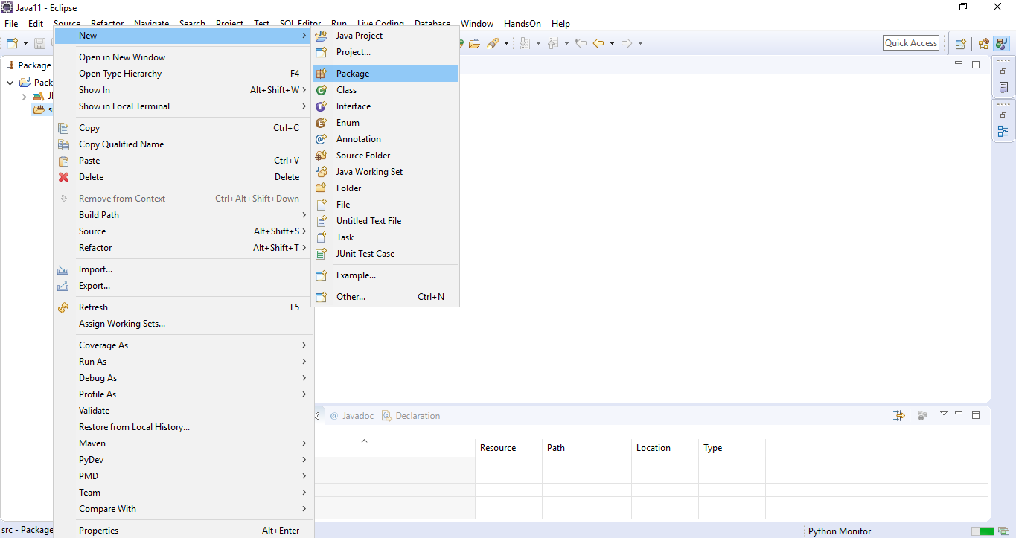
Step 2: Right click on src and select New>Package to create a new package as shown below.

Slide 90
Name the package as com.hnd.package1.
Step 3: Right click on the package name and select New>Class to create a new class in com.cap.package1
Name the class as DemoOne.
Step 4: Create three variables named variableOne, variableTwo and variableThree with public, private and default access modifiers respectively in the class DemoOne.
public class DemoOne {
public int variableOne;
private int variableTwo;
int variableThree;
}
Step 5: Add another class named DemoTwo in com.hnd.package1.
Step 6: Create a method checkAccessibility as shown below in the class DemoTwo. This method will be used to check the accessibility of the variables of class DemoOne in class DemoTwo.

Slide 91
public class DemoTwo {
public void checkAccessibility() {
}
}
Step 7: Create an object of class DemoOne in the method checkAccessibility as shown below.
public class DemoTwo {
public void checkAccessibility() {
DemoOne demoOne=new DemoOne();
}
}
Step 8: Try to access and initialize variableOne in the method checkAccessibility() as shown below.
public class DemoTwo {
public void checkAccessibility() {
DemoOne demoOne=new DemoOne();
demoOne.variableOne=1;
}
}

Slide 92
You can observe that variableOne of class DemoOne is accessible in the class DemoTwo as variableOne is public and hence, can be accessed anywhere.
Step 9: Now, try to access variableTwo in the method checkAccessibility() as shown below.
public class DemoTwo {
public void checkAccessibility() {
DemoOne demoOne=new DemoOne();
demoOne.variableOne=1;
demoOne.variableTwo=1;
}
}
you can observe that you get a compilation error stating 'The field DemoOne.variableTwo is not visible' while trying to access variableTwo of class DemoOne in the class DemoTwo as variableTwo is private and hence, can be accessed only within the class in which it is defined.
Step 10: Now, try to access variableThree and initialize it in the method checkAccessibility() as shown below.

Slide 93
public class DemoTwo {
public void checkAccessibility() {
DemoOne demoOne=new DemoOne();
demoOne.variableOne=1;
demoOne.variableThree=1;
}
}
You can observe that variableThree of class DemoOne is accessible in the class DemoTwo as variableThree is default and hence, can be accessible anywhere within the same package.
Step 11: Add another package named com.hnd.package2 in the same project.
Step 12: Create a class named DemoThree in com.hnd.package2.
Step 13: Create a method checkAccessibility as shown below in the class DemoThree. This method will be used to check the accessibility of the variables created in class DemoOne in class DemoThree.
public class DemoThree {
public void checkAccessibility() {
}
}

Slide 94
Step 14: Create an object of class DemoOne in the method checkAccessibility as shown below.
public class DemoThree {
public void checkAccessibility() {
DemoOne demoOne=new DemoOne();
}
}
You will now observe a compilation error stating 'DemoOne cannot be resolved
This error is coming as the classes DemoOne and DemoThree are present in different packages.
Step 15: To use or access the class DemoOne in the class DemoThree, you can use com.cap.package1.DemoOne, i.e., <package_name>.<class_name> as shown below.
public class DemoThree {
public void checkAccessibility() {
com.hnd.package1.DemoOne demoOne=new com.hnd.package1.DemoOne();
}
}

Slide 95
In this approach, you have to use the fully qualified name (<package_name>.<class_name>) every time you need to access the class. Hence, this is not a recommended approach.
Instead, it is recommended to import the required classes using import statement.
Step 16: Import the class named DemoOne from com.infy.package1 to com.hnd.package2 using the import statement as shown below.
package com.hnd.package2;
import com.hnd.package1.DemoOne;
public class DemoThree {
public void checkAccessibility() {
DemoOne demoOne=new DemoOne();
}
}
To import all the classes present inside a given package, import <package_name>.* can be used.
If you use <package_name>.*, then all the classes of the package will be imported but the classes present inside the sub packages will not be available for use.

Slide 96
Step 17: Now that you have imported class DemoOne in com.hnd.package2, try to access variableOne and initialize it in the method checkAccessibility() as shown below.
public class DemoThree {
public void checkAccessibility() {
DemoOne demoOne=new DemoOne();
demoOne.variableOne=1;
}
}
You can observe that variableOne of class DemoOne is accessible in the class DemoThree as variableOne is public and hence, can be accessed anywhere.
Step 18: Now, try to access variableTwo in the method checkAccessibility() as shown below.
public class DemoThree {
public void checkAccessibility() {
DemoOne demoOne=new DemoOne();
demoOne.variableOne=1;
demoOne.variableTwo=1;
}
}

Slide 97
You can observe that you get a compilation error stating 'The field DemoOne.variableTwo is not visible' while trying to access variableTwo of class DemoOne in the class DemoThree as variableTwo is private and hence, can be accessed only within the class in which it is defined.
Step 19: Now, try to access variableThree and initialize it in the method checkAccessibility() as shown below.
public class DemoThree {
public void checkAccessibility() {
DemoOne demoOne=new DemoOne();
demoOne.variableOne=1;
demoOne.variableThree=1;
}
}
You can observe that you again get a compilation error stating 'The field DemoOne.variableTwo is not visible' while trying to access variableThree of class DemoOne in the class DemoThree as variableThree is default and hence, can be accessed only within the package in which it is defined.
So, through this demo, you would have understood the scope of the different access modifiers and how to access a class of one package in another using import statement.

Slide 98
String class
Next, we will look at some of the built-in classes available in Java.
The first built-in class that we will see is the String class.
As we all know already, a sequence of characters can be stored using a variable of String.
There are two ways to create a string:
String literal
E.g. String customerName = "Jasmine";
Using new() keyword
E.g. String customerName = new String("Jasmine");
In the following demo, we will understand how to create string in two ways.

Slide 99
//String creation using = operator
String name = "Jasmine";
//String creation using new()
String customerName = new String("Jasmine");
System.out.println(name); //Output: Jasmine
System.out.println(customerName); //Output: Jasmine
String methods:
Java String class provides a collection of built-in methods which help in performing various operations on string.
Some of which are:

Slide 100
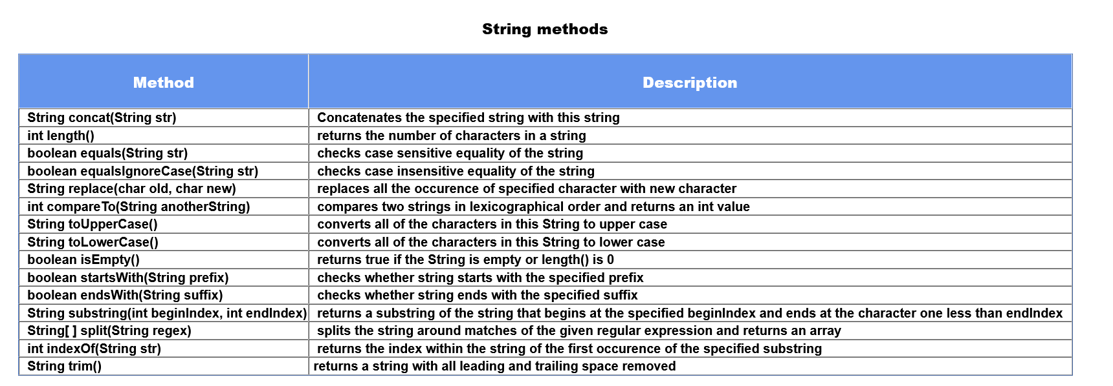

Slide 101

Few of the methods that are introduced since Java 11 are:
All these methods will be discussed in the tryout.

Slide 102
In the demo given below, we compare two strings using equals and equalsIgnoreCase method. We manipulate the given string using methods like replace() and concat(). Similarly, using other methods we can manipulate the strings.
String name = "Thomas";
String customerName = new String("THOMAS");
boolean result1 = name.equals(customerName); // result1 = false
boolean result2 = name.equalsIgnoreCase(customerName); //result2 = true
String username = name.concat("#24"); // will concatenate #24 to name i.e Thomas#24
String newString = customerName.replace("M", "m"); // Will replace all occurence of M to m
// i.e THOmAS
In the next page we will discuss the immutable nature of string and will figure out an alternative to String.

Slide 103
Consider a scenario, where we have to modify the variable name = "Oliver" to "Oliver Carter". To implement this we will use concat method as shown below.
String name = "Oliver";
name.concat(" Carter");
System.out.println(name); //Output Oliver
In the above example, we have string "Oliver" referred by the variable name. Even after using concat, name("Oliver") is not changed, rather a new object is created "Oliver Carter", having no reference. This is because String in Java is immutable. Immutable means which cannot be changed.
To solve this we will use a mutable class known as StringBuilder. StringBuilder class consists of the append method that concatenates the string with the specified argument which might solve our problem. Let's learn more about StringBuilder Class.

Slide 104
StringBuilder Class
StringBuilder Objects are similar to String objects but they can be modified hence they are mutable. This means if we try to modify the original string, a new string will not be generated instead original string will get changed. In one way we can say that StringBuilder will reduce memory usage. It provides an alternative to the String class, it is mutable and easy to use.
The creation of StringBuilder object is shown below
//create StringBuilder object
StringBuilder name = new StringBuilder();
name.append("Oliver");
name.append(" Carter");
System.out.println(name); //Output: Oliver Carter
As given in the code, we can modify the object using the append method and can create StringBuilder objects in a different way. We will discuss some of the methods of StringBuilder.

Slide 105

Some of the most used methods of StringBuilder are given as follows:-
The implementation of these methods will see in the demo given below.
//creation of StringBuilder Object with capacity 50.
StringBuilder name = new StringBuilder(50);
name.append("Mississippi");
int length = name.length(); // will give the length of address
name.insert(length, " River");
System.out.println(name); //Output :- Mississippi River
name.reverse(); // Output :- reviR ippississiM
name.delete(5, 10); // Output :- reviRssissiM
System.out.println(name.charAt(3)); // Output :- i

Slide 106
String methods - Tryout 1
Problem Statement:
Play around with different String class methods for you to explore like concat(), equals(), equalsIgnoreCase(), compareTo().
Uncomment the code as explained and observe the output.
class Tester {
public static void main(String[] args) {
//creation of string using string literal
String firstString = "Java";
//creation of string using new keyword
String secondString = new String("Stream");
/*
Task 1 :- using concat() display Java Stream
*/
System.out.println("------------"+"concat()"+"------------");
System.out.println("Concatenating using concat() :- "+firstString.concat(secondString));
System.out.println();
/*
Task 2 :- string comparison using equals(), == operator, compareTo()
*/
System.out.println("------------"+"Comparison(.equals , == , compareTo)"+"------------");
String thirdString = "Thomas";
String fourthString = "THOMAS";
System.out.println("Comparison of Thomas with THOMAS using equals :- "+thirdString.equals(fourthString));
//string1.equalsIgnoreCase(string2) => case insensitive comparison
System.out.println("Comparison of Thomas with THOMAS using equals ignoring case:- "+thirdString.equalsIgnoreCase(fourthString));

Slide 107
System.out.println();
//using == operator
String fifthString = "Thomas";
String sixthString = new String("Thomas");
System.out.println("Comparison using == operator :- "+(thirdString==fifthString));
//Line 36 both refer to same instance
System.out.println("Comparison using == operator with new keyword :- "+(sixthString==fifthString));
//Line 39 sixthString refers to instance created in nonpool
System.out.println();
//using compareTo()
/*
if s1 and s2 are two strings which are to be compared
if s1 == s2 then output is 0
if s1 > s2 then output is 1
if s1 < s2 then output is -1
*/
System.out.println("Comparison of Thomas and Thomas using comapreTo :- "+(thirdString.compareTo(fifthString)));
System.out.println("Comparison of Thomas and RudolfShelby using compareTo :- "+(thirdString.compareTo("RudolfShelby")));
}
}

Slide 108
Problem Statement:
Here are some new methods of String introduced in Java 11. Some of these methods like repeat(), isBlank(), strip(), stripLeading(), stripTrailing(), lines() are discussed in the tryout.
import java.util.stream.Stream;
class Tester {
public static void main(String[] args) {
System.out.println();
System.out.println("------------"+"Java 11 String methods"+"------------");
String one = "amazon";
System.out.println("Repeat method used to repeat the string having count passed as parameter");
System.out.println("Repeat string one 3 times :-"+one.repeat(3));
System.out.println();
String two = "Antarctica";
System.out.println("isBlank() tells us whether the string contains only Blank spaces");
System.out.println("Checking isBlank() with string two :- "+two.isBlank());
String blank=" ";
System.out.println("Checking isBlank() with string blank :- "+blank.isBlank());
System.out.println();
String whiteSpaceLeadingAndTrailing = " Pacific ";
String whiteSpaceLeading = " Pacific";
String whiteSpaceTrailing = "Pacific ";

Slide 109
System.out.println("In Java 11, we have three methods to remove extra white-spaces\n"
+ "1.strip() => All the leading and trailing white-spaces are removed.\n"
+ "2.stripLeading() => All the leading white-spaces are removed.\n"
+ "3.stripTrailing() => All the trailing white-spaces are removed.\n"
+ "These methods are extension to the trim() method which we have already seen\n");
System.out.println("----Demo----");
System.out.println("Using strip() :- "+whiteSpaceLeadingAndTrailing.strip());
System.out.println("Using stripLeading() :- "+whiteSpaceLeading.stripLeading());
System.out.println("Using stripTrailing() :- "+whiteSpaceTrailing.stripTrailing());
System.out.println();
System.out.println("String.lines() splits the string by its line terminators and returns a Stream of Strings");
String str1 = "A \n B \n C \n D";
System.out.println("Use String.lines() on string str1");
Stream<String> lines = str1.lines();
lines.forEach(System.out::println);
}
}

Slide 110
Problem Statement
Have a look at how mutable strings can be manipulated. Some of its methods like insert(), append(), capacity(), delete(), length() are discussed.
class Tester {
public static void main(String[] args) {
//Creating StringBuilder Objects
StringBuilder strOne = new StringBuilder("Java");
StringBuilder strTwo = new StringBuilder();
strTwo.append("Python");
// method will return length of strOne
Integer length = strOne.length();
//method will insert a new string to the original string
strTwo.insert(0,"I love ");
System.out.println(strTwo);
// method will append 2.0
strOne.append(9.0);
System.out.println(strOne);

Slide 111
//to print the capacity of object we use capacity()
System.out.println(strOne.capacity());
//this method will insert SE into strOne at specified position
strOne.insert(length,"SE");
System.out.println(strOne);
//this method will create a string from start index till end index as specified
String sub = strTwo.substring(4,9);
System.out.println(sub);
//this method can convert StringBuilder Object
String str = strTwo.toString();
System.out.println(str.getClass());
// this method deletes characters from strOne based on the arguments specified
strOne.delete(0,3);
System.out.println(strOne);
}
}

Slide 112

Wrapper Class
All this time, we have been using primitive types. But there are occasions where we need to represent them as Objects. This is where Wrapper classes come into the picture. A wrapper class is the one which contains or wraps the primitive data types (int, char, etc.)
All the primitive data types have their corresponding Wrapper classes. The following table shows the primitive data types and their corresponding Wrapper class.

Slide 113
Wrapper classes also provide a number of useful methods to manipulate values. They belong to the java.lang package as part of the Java library.
Integer wrappedInt = new Integer(2);
Since Java 5, this can be done without an explicit call to the constructor
char value = 'a';
Character wrappedChar = value;
This mechanism is called autoboxing which means automatic conversion of primitive types to the object of their corresponding wrapper classes is known as autoboxing. For example – conversion of char to Character as shown above.

Slide 114
Similarly, there is a process of unboxing which is opposite of autoboxing. In this process automatically conversion of a wrapper class object to its corresponding primitive type is performed. For example refer the
code given below.
char newVal = wrappedChar;
Important Note: Similar to the String pool, Byte, Short, Integer and Long classes cache values in the range -128 to 127.
Next, let us discuss few methods which are present in a wrapper class.

Slide 115
Wrapper Class Methods
Wrapper classes are helpful in converting numeric strings into numeric datatypes (for example String-to-int, String-to-double etc.). And so, we have supporting methods like parseDouble(), parseInt(), etc.
Each such method accepts a string and returns an object of the corresponding data type. Let's look at the Integer class for instance.
String sum = "123";
int mySum = Integer.parseInt(sum);// Here 'mySum' would be holding the integer 123
Also, typecasting fails in converting a wrapper type to another type. So, we can use methods such as intValue(), byteValue(), floatValue() etc. to do such conversions. Let's take a look at the following example:
Integer phoneNo = 44281234;
Long phoneNo = phoneNo.longValue(); // Converts Integer into a Long value
Now we will see some of the methods of Character wrapper class :
We create two objects alphaObj and digitObj as shown:

Slide 116
Character alphaObj = new Character('A');
Character digitObj = new Character('5');
Following are some of the methods which make our task to manipulate the data, easy.
isDigit() - checks if a given character is Digit
isUpperCase() - checks if a given character is LowerCase
toString() - converts Character to String
charValue() - converts Character to char primitive data type
toLowerCase() - converts Character to LowerCase
boolean result1 = Character.isDigit(digitObj); // Output :- true
boolean result2 = Character.isUpperCase(alphaObj); // Output :- true
String val = alphaObj.toString(); // val = "A"
char beta = alphaObj.charValue(); // beta = 'A'
char c = Character.toLowerCase('B'); // c = 'b';

Slide 117
We will see some methods which introduce comparison.
int result11 = Character.compare('A', 'b');
System.out.println(result11); //-33
Character anotherCharacter = new Character('b');
int result22 = alphaObj.compareTo(anotherCharacter);
System.out.println(result22); //-33
As you can see, both the methods are giving the same output then, what is the difference between them?
If you observe both the methods carefully you will come to know, in compare() we are comparing the two char values (In this case 'A' and 'b') and in compareTo() we are comparing two objects of Character wrapper class.

Slide 118
The working of both the methods is given below.
compare() :-
Comparing chars using compare which returns an int
It returns 0 if char1 == char2
a value less than 0 if char1 < char2
a value greater than 0 if char1 > char1
2. compareTo() :-
Comparing Character objects using compareTo which returns int
It returns 0 if obj1 == obj2
a value less than 0 if obj1 < obj2
a value greater than 0 if obj1 > obj2
You will explore more of wrapper class methods in the tryout.

Slide 119
Wrapper Classes - Tryout
Problem Statement :
In this code we will discuss how the Character Wrapper class along with various methods which can be used in different scenarios.
//This program demonstrates usage of various methods in Character Wrapper class
class Tester {
public static void main(String[] args) {
//Creating Character instances using valueOf()
Character alphaObj = Character.valueOf('A');
Character digitObj = Character.valueOf('5');
//method to check if a given character is Alphabet
System.out.println("Z is Alphabet:"+Character.isLetter('Z'));
//method to check if a given character is Digit
System.out.println("5 is Digit:"+Character.isDigit(digitObj));
//method to check if a given character is LowerCase
System.out.println("b is LowerCase:"+Character.isUpperCase('b'));
//method to convert to LowerCase
System.out.println(Character.toLowerCase('Z'));
System.out.println(Character.toLowerCase(66));

Slide 120
//method to convert Character to String
String xobj = Character.toString('x');
System.out.println(xobj);
//method to convert Character to char primitive data type
char alpha = alphaObj.charValue();
System.out.println(alpha);
//Comparing chars using compare which returns int
//It returns 0 if char1 == char2;
//a value less than 0 if char1 < char2;
//and a value greater than 0 if char1 > char1
System.out.println(Character.compare('A', 'b'));
//Comparing Character objects using compareTo which returns int
//It returns 0 if obj1 == obj2;
//a value less than 0 if obj1 < obj2;
//and a value greater than 0 if obj1 > obj2
Character anotherCharacter = Character.valueOf('b');
System.out.println(alphaObj.compareTo(anotherCharacter));
}
}

Slide 121
Arrays
An array is a collection of similar data in contiguous memory locations referred to by the same name. It is an object in Java and is created dynamically.
Syntax:
<data type><variable name>[ ] = new <data type>[size];
(or)
<data type>[ ] <variable name> = new <data type>[size];
Creating, initializing and accessing an array:
We initialize array pizzaCost and add elements to it as shown below.

Slide 122
int pizzaCost[]=new int[3];
pizzaCost[0]=100;
pizzaCost[1]=250;
pizzaCost[2]=390;
To access each element in the array, we are going to use a for loop as shown.
//Accessing elements using for loop
for (int index; index < pizzaCost.length; index++) {
System.out.println(pizzaCost[index]);
}
You can use different loops to iterate and access each element of the array. Example of forEach loop is shown below
//Accessing elements using for-each loop
for (int cost : pizzaCost) {
System.out.println(cost);
}

Slide 123
The type of arrays which we have learned is one dimensional, can we have multi-dimensional arrays?
Have you ever tried to store the data in a matrix?
The solution of the same you will get in the next module.
We can also have multi-dimensional arrays. In simple words, we define multidimensional arrays as an array of arrays. Data in the mutli-dimensional array is stored in the tabular form (you can think of a matrix for better understanding).
Syntax:
<data_type>[1st dimension][2nd dimension][]...[nth dimension] <arrayName> = new <data_type>[size1][size2]….[sizeN];

Slide 124
Now we will see the examples of declaring a multi-dimensional array.
Examples:
Two dimensional array: int[][] 2dArray = new int[10][20];
Three dimensional array: String[][][] 3dArray = new String[10][20][30];
Declaration of the array given above is the direct method of declaration, here we specify the size at the time of declaring an array. To set the values we make use of the dimensions(rows and columns).
For example, see the code given below.
String[][] names = new String[7][3]; // Here, 7 is the row size; 3 is the column size (optional)
// To set value of first row second column
names[1][2] = "Oliver";
// To set value of second row first column
names[2][1] = "Josh";

Slide 125
Now you will see the indirect method of declaring a 2-D array. Consider the array given below having four rows and three columns
// Another way of creating a 2-D array
String[][] names = new String[][] {
{"Robert", "Shelly", "Scarlett"},
{"Mark", "Oliver", "Chris"},
{"Emmy", "Josh", "Merry"},
{"Evelyn", "Austin", "Emma"}
};
To access any element of the array we refer its position i.e. arrayName[row][column].
For example:
String value = names[0][1];
// value = Shelly

Slide 126
Now you will learn how to iterate over the multi-dimensional array.
for(int i=0;i<names.length;i++) {
for(int j=0;j<names[i].length;j++) {
System.out.print(names[i][j]+" "); // where i refers to row
// and j refers to column
}
System.out.println();
}
As you can see, we have used two for loops to iterate over array(names). Outer for loop is used to iterate each row of the 2D array (for better understanding consider it as a 2D matrix) and the inner one iterates over each element in the row.
Now as we have learned the concept of array thoroughly, can we create an array of user-defined objects?
What kind of array that will be? Let us see that next.

Slide 127
An object represents a single record in memory, consider a scenario where we want multiple records (objects) at a time, in that case, you will have to use arrays which will be called as an array of objects. Make a note, arrays can hold the only reference of the objects and not the object. Let us see how to create an array of objects.
Example: Consider a class Account consisting of two attributes account holder's name and its bank account number. We have to show the information of each account holder present in the bank. To make operation easy we have to make use of arrays.
First, in order to use an object, you should define the structure of the class Account.
class Account{
String name;
long accountNumber;
}

Slide 128
Now to perform the required operation we have to define two methods, one for setting the data and others for displaying the information. These methods will be called by the objects every time, to perform the operation.
Accordingly, the structure of the class Account will become as given below:
class Account{
String name;
long accountNumber;
void setData(String custName,int accNum) {
this.name = custName;
this.accountNumber = accNum;
}
void display() {
System.out.println("Name :- "+name);
System.out.println("Account Number :- "+accountNumber);
}
}

Slide 129
Next task is to declare an array, which is shown below:
// creating array of type Account having size 3
Account accArray[] = new Account[3];
After completing the declaration, now comes the part where we have to create an object and set the data (account holder's name and account number).
//first create the object of Account
//and then set the data for each object
accArray[0] = new Account();
accArray[0].setData("Ella",345234);
accArray[1] = new Account();
accArray[1].setData("Scarlet",345278);
accArray[2] = new Account();
accArray[2].setData("Harper",345897);

Slide 130
We can call the method display using these objects individually (accArray[0].display()) as the total number of objects is 5, but what if we have more than one thousand objects? Therefore we make use of loops, enhanced for loop is preferred as it is easier than traditional for loop.
See the code given below to get the grip of an idea.
System.out.println("Account holder's information");
System.out.println();
for (Account account : accArray) {
account.display();
System.out.println();
}
You will further explore this concept in tryouts.

Slide 131
Java also has a inbuilt class named Arrays which contains various methods for performing operations like searching and sorting on arrays.
Arrays is an inbuilt Java class belonging to java.util package. It has many static methods for quick comparing, searching, sorting of arrays and other utility methods. Many of these methods help us to do away with loops required for manipulating and accessing arrays.
Arrays is an inbuilt class and should not be confused with an array which is collection of homogeneous elements.
Methods of the class can be called using below syntax –
Arrays.<<method name>>
Example
int[] numArr = {6,8,9,10,40,66};
int resultIndex = Arrays.binarySearch(numArr, 40);

Slide 132
Here index of the search element will be returned. A negative index is returned if element is not found.
Another useful method is equals() -
int[] numArr1 = {6,8,9,10,40,66};
int[] numArr2 = {6,8,9,10,40,66};
boolean resultCompare = Arrays.equals(numArr1, numArr2);
System.out.println(resultCompare); //prints true or false
To sort an array we just need to do the following-
int[] numArr = {6,8,9,10,40,66};
Arrays.sort(numArr);
sort() method does not return any value and changes the content of original array.
Arrays class provides its own version of toString() method which can be used to quickly print elements of an array.

Slide 133
int[] numArr = {6,8,9,10,40,66};
System.out.println(Arrays.toString(numArr));
Problem Statement:
Hi, this is Pizzeria again! Thanks for your help with the bill calculation issue. It was very helpful.
We need your help with another issue. We serve three different sizes of pizza, and each of them has a different cost. Along with this, the customer can also order multiple pizzas of different sizes. So, create a Java code snippet to calculate the bill for the same.
Note: The three pizza sizes along with their prices are: Regular - 100, Medium - 250 and Large - 390. Just like the last time, provide a 5% discount to each order.
Execute the following code in JShell.

Slide 134
Step1: First, let us store the different pizza sizes and their costs in arrays. Since arrays can hold only one entity in one index, we will create two arrays having one-one correspondence,
String[] pizzaSize = {"Regular", "Medium", "Large"};
int[] pizzaCost = {100, 250, 390};
Step 2: We will take the order from the customer. Since the customer can order multiple pizzas of different sizes, we will store his order in two arrays. One array for the different sizes ordered, and one for the quantity ordered for each of the sizes.
String[] pizzaOrdered = {"Medium", "Regular"};
int[] quantityOrdered = {2, 1};
Step 3: Next, we will run a for-loop against the pizzaOrdered array, take each element from the array, check if that is present in the pizzaSize array. If it is present, take the cost of that pizza, multiply it with the required quantity and add it to the totalAmount,

Slide 135
float totalAmount = 0f;
for(int index1 = 0; index1 < pizzaOrdered.length ; index1++) {
for(int index2 = 0; index2 < pizzaSize.length ; index2++) {
if ( pizzaOrdered[index1] == pizzaSize[index2] ) {
totalAmount += pizzaCost[index2] * quantityOrdered[index1];
}
else {
totalAmount += 0;
}
}
}
Step 4: Provide the discount for the order,
totalAmount = totalAmount - (totalAmount*(float)5/100);

Slide 136
Step 5: In the end, our code will look like this and it is ready to execute
String[] pizzaSize = {"Regular", "Medium", "Large"};
int[] pizzaCost = {100, 250, 390};
String[] pizzaOrdered = {"Medium", "Regular"};
int[] quantityOrdered = {2, 1};
float totalAmount = 0f;
for(int index1 = 0; index1 < pizzaOrdered.length ; index1++) {
for(int index2 = 0; index2 < pizzaSize.length ; index2++) {
if ( pizzaOrdered[index1] == pizzaSize[index2] ) {
totalAmount += pizzaCost[index2] * quantityOrdered[index1];
}
else {
totalAmount += 0;
}
}
}
totalAmount = totalAmount - (totalAmount*(float)5/100);
System.out.println("Your total bill amount is: "+totalAmount);

Slide 137
Step 6: Output would look like as below
Your total bill amount is: 570.0

Slide 138
Arrays - Tryout 1
Control Structures and Arrays
Problem Statement We have the scores of last 7 cricket matches India has played. For the purpose of analyzing their performance, we need to find the average score, the number of scores below it, those equal to it, and those above it.
Consider that the scores (runs) are stored in an array of int values.
Create a class CricketScore and write a program to implement the above requirement.
Sample:
Input:
int score = {281, 344, 265, 272, 236, 324, 287};
Output: The average score of the team is 287 runs No. of matches having score above average is 2 No. of matches having score equal to average is 1 No. of matches having score below average is 4

Slide 139
class Tester{
public static void main(String a[]){
//After implementing, copy the below code in JShell to execute
int scores[]={281, 344, 265, 272, 236, 324, 287};
double sum=0,avg=0;
for(int index=0;index<scores.length;index++){
sum=sum+scores[index];
}
avg=sum/scores.length;
System.out.println("The average score of the team is "+avg);
//Complete the code as desired output shown in problem statement
}
}

Slide 140
Arrays - Tryout 2
Problem Statement:
Here in this tryout, we will demonstrate the use of arrays with objects.
We have to create an array of objects having a user-defined datatype Account and iterate over these objects to display the information.

Slide 141
class Account{
String name;
long accountNumber;
void setData(String custName,int accNum) {
this.name = custName;
this.accountNumber = accNum;
}
void display() {
System.out.println("Name :- "+name);
System.out.println("Account Number :- "+accountNumber);
}
}
class Tester {
public static void main(String args[]) {
// creating array of type Account having size 3
Account accArray[] = new Account[3];
// first create the object of Account
// and then set the data for each object
accArray[0] = new Account();
accArray[0].setData("Ella",345234);
accArray[1] = new Account();
accArray[1].setData("Scarlet",345278);
accArray[2] = new Account();
accArray[2].setData("Harper",345897);
System.out.println("Account holder's information");
System.out.println();
for (Account account : accArray) {
account.display();
System.out.println();
}
}
}

Slide 142
Enumeration
Enumerations are group of named constants. All enums implicitly extend the java.lang.Enum class. The enum fields are implicitly static and final, and hence are constant during compile time. But they are instances of their enum type, constructed when the enum type is referenced for the first time.
Why do we need these grouped constants?
Let us assume that a developer is creating online Pizza ordering application. He wants to allow the customers to choose the size of the pizza. The sizes allowed are small, medium and large only. He realizes that having the type of the size variable as String has a chance of some developer entering any arbitrary size. And this could cause invalid processing. How can we stop the Pizza size to be initialized anything other than these three values.
Using enums allows us to limit the selection within a set of values.
An enum is a datatype which contains a fixed set of constant values. For example,
directions (NORTH, EAST, WEST, SOUTH)
pizzaSize (SMALL, MEDIUM, LARGE)

Slide 143
Syntax:
public enum enum_name { constant1, constant2, ..., constant n }
Example:
public enum PizzaSize { SMALL, MEDIUM, LARGE }
This type can be declared to limit the usage to the above 3 values.
private PizzaSize size;
Let us see what all things can be done with enum based variables next.

Slide 144
Let us look at some features about enums:
Enums are considered as reference-types like classes and interfaces in Java, and hence, a programmer can define constructors, methods and variables, inside them.
A static method called values() is automatically generated by the Java compiler for each enum. The values() method returns an array of all the constant values defined inside the enum.
Enum variables can be used in an if statement or switch statement.
if statement-
if(this.size.equals(PizzaSize.MEDIUM)){
System.out.println("Size is Medium");
}

Slide 145
switch statement-
PizzaSize currentSize = PizzaSize.MEDIUM;
double discount = 0;
// using enum in switch case
switch (currentSize) {
case SMALL:
discount = 10;
break;
case MEDIUM:
discount = 20.5;
break;
case LARGE:
discount = 30.2;
break;
}

Slide 146
We can loop through the enum and print constant values.
for loop-
//values() method returns an array of all values inside enum
//ordinal() method can be used to display values assigned to enum constants
for (PizzaSize psize : PizzaSize.values()) {
System.out.println(psize+" "+psize.ordinal());
}
Let us practice enums further in the tryouts.

Slide 147
Enumeration - Tryout
Problem Statement :
Pizza size is defined in Enum with SMALL, MEDIUM, LARGE sizes. Pizza size identified to get the respective discount. This demo helps to learn different methods of Enumeration and to know the better usage.
//Enumeration of Pizza Sizes
enum PizzaSize {
SMALL, MEDIUM, LARGE
}
class Pizza {
private String pizzaName;
private double price;
//can take only three values SMALL, MEDIUM, LARGE. Anyother value will give error
private PizzaSize size;
public Pizza(String pizzaName, double price, PizzaSize size) {
this.pizzaName = pizzaName;
this.price = price;
this.size = size;
}

Slide 148
public double checkDiscount() {
PizzaSize currentSize = this.size;
double discount = 0;
// enum can be used in switch case
switch (currentSize) {
case SMALL:
discount = 10;
break;
case MEDIUM:
discount = 20.5;
break;
case LARGE:
discount = 30.2;
break;
}
return discount;
}

Slide 149
public static void main(String[] args) {
Pizza myPizza = new Pizza("VegFeast", 500, PizzaSize.MEDIUM);
System.out.println("Discount:" + myPizza.checkDiscount());
// displaying all Pizza sizes
//values() method returns an array of all values inside enum
//ordinal() method can be used to display values assigned to enum constants
for (PizzaSize psize : PizzaSize.values()) {
System.out.println(psize+" "+psize.ordinal());
}
}
}

Slide 150
Code Quality - SonarLint

